Slide 1
Lecture 2- Stratigraphy & Relative Time
PT 1- A History of Time
PT 2- Stratigraphic Principles
PT 3- Correlation Techniques

Slide 2
Introduction
2 approaches to dating:
Absolute-
Relative-
Q: what’s the difference?

Slide 3
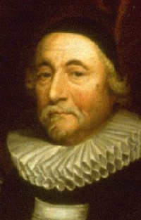
PT 1- A History of Time
James Ussher: Sun, 10/23/4004 BC
Became doctrine in 1701
Buffon (mid 1700s): 75 ka based on cooling rates
Joly (mid 1800s): 90 Ma based on salinity

Slide 4
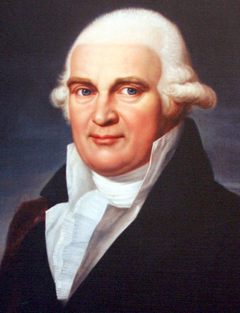
Neptunism
Werner (mid 1700s)
Widely accepted in late 1700s
Fit with the Genesis flood
Probs:
  1- water loss
  2- basalts

Slide 5
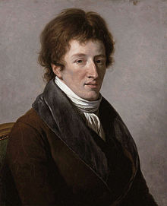
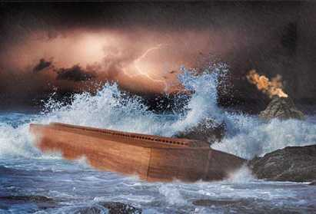
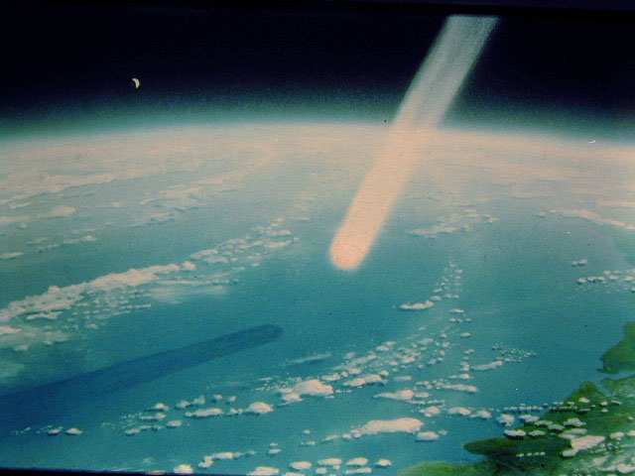
Catastrophism
Cuvier (late 1700s)
6 global disasters
Also fit with church doctrine
Catastrophic events do play a role

Slide 6
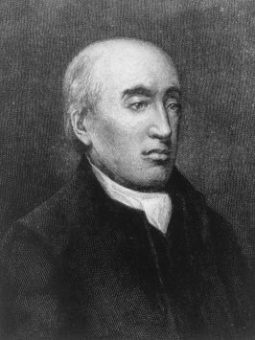
Uniformitarianism
James Hutton (1795, Scotland)
Theory of the Earth
Requires lots of time

Slide 7
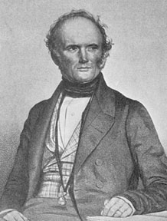
Uniformitarianism
Promoted by Lyell (mid 1800s)
Principles of Geology (1830)
Later came Actualism- Rates & intensities may vary, but basic processes do not

Slide 8
PT 2-
Stratigraphic Principles
Stratigraphy
Basis for Relative Age Dating
Steno (mid 1600s)
1- P. of Original Horizontality-

Slide 9
Stratigraphic Principles
2- P. of Superposition-
youngest
In-between
oldest

Slide 10
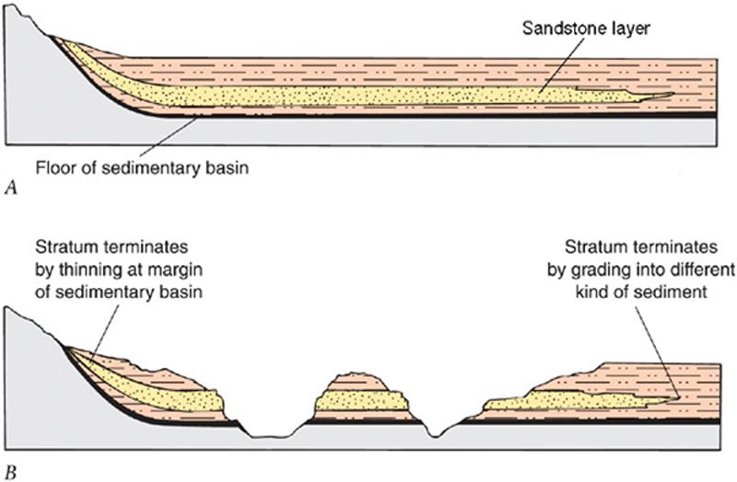
Stratigraphic Principles
3- P. of Lateral Continuity
  Thin/pinch out
  Gradual transition
  Intertongue

Slide 11
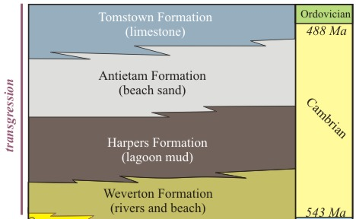
Next Topic:
Sea Level Changes & Strata
Walther’s Law- As sea level changes, sed facies migrate laterally & thus overlie ea other
  Ex: sand overlain by shale overlain by LS
  Only works if you have a continuous sedimentary record

Slide 12
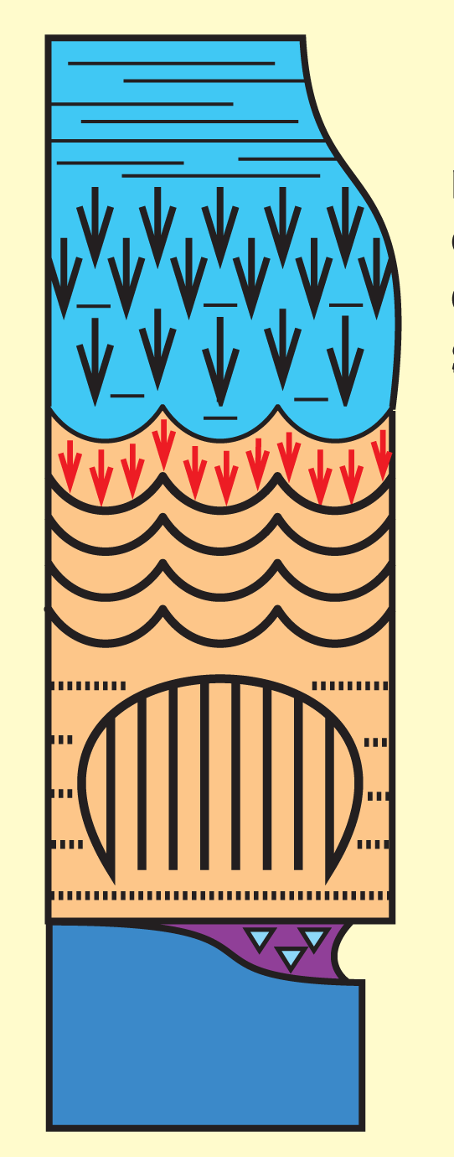
Sea Level Changes
Transgression
  Fining upwards
Regression
  Coarsening upwards

Slide 13
Sea Level Changes
Causes of sea level change:
  1- Uplift & subsidence
  2- Glacial-interglacial periods
  3- Seafloor spreading rate changes

Slide 14
More On Stratigraphy
No one place on Earth has a continuous record of strata from all Earth’s history
Leads to gaps in the stratigraphic record
8 Ma
9 Ma
8 Ma
10 Ma
10 Ma

Slide 15
Unconformities
Hutton
A gap in the stratigraphic record
Q: What are 3 reasons gaps may form?
3 types, classified by strata relations

Slide 16
Types of Unconformities
1- Disconformity- Sedimentary rocks above and below the unconformity
2- Nonconformity- Seds overlie ig/met rocks
shale
shale
Siltstone
basalt

Slide 17
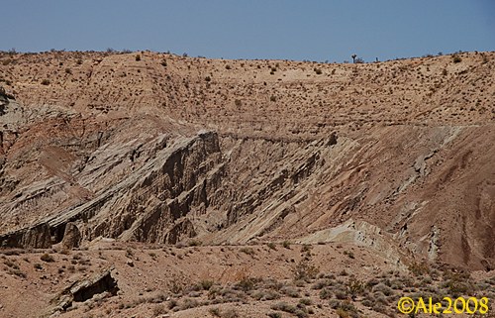
Types of Unconformities
3- Angular Unconformity-
Several steps involved
  Long time

Slide 18
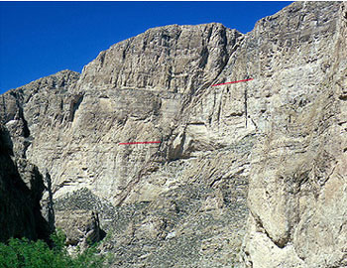
More Stratigraphic Principles
4- P. of Cross-Cutting
Hutton

Slide 19
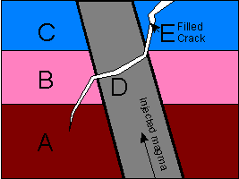
What is the Youngest Feature?

Slide 20
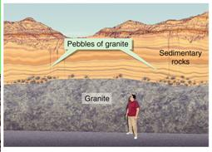
Stratigraphic Principles
5- P. of Inclusions

Slide 21
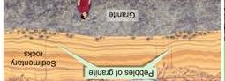
Stratigraphic Principles
Check of Superposition
Authigenic

Slide 22
PT 3- Correlation
Problem: Can’t tell which area has the oldest rocks
South Carolina
Texas

Slide 23
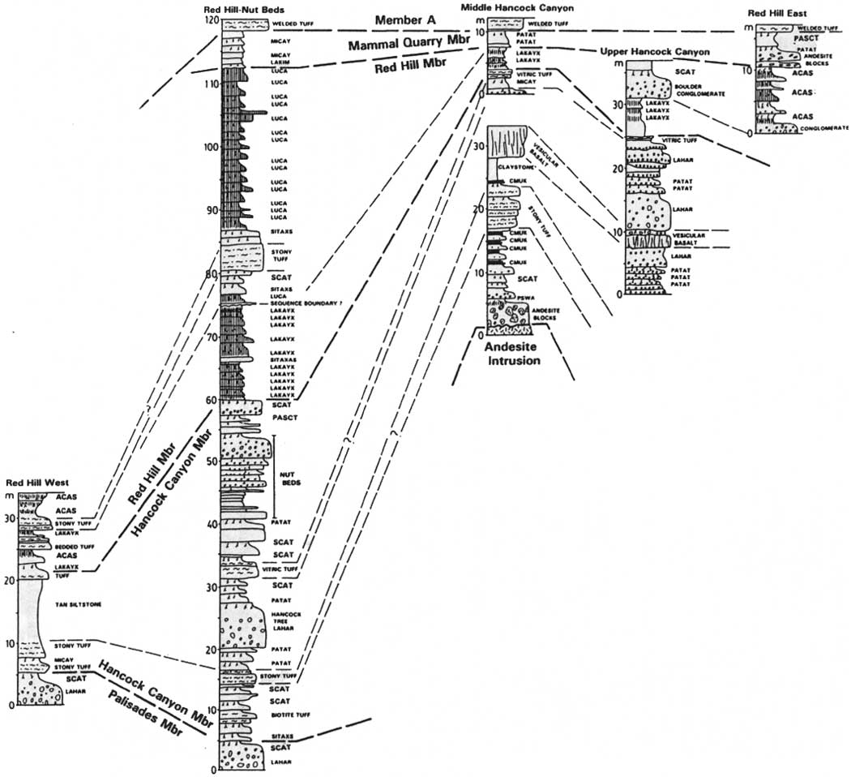
Correlation
Fence Diagrams
Several correlation methods (1-6)

Slide 24
#1 Lithostratigraphy
Based just on rk type, not age
  Ex: follow a layer of beach sand
Q: what’s the catch with this approach?
Time transgressive (i.e., asynchronous)
siltstone
siltstone
sandstone
sandstone
breccia
sandstone
breccia
conglomerate

Slide 25
Lithostratigraphic Units
Largest - smallest
  Supergroup
  Group
  Formation- mappable rk body w/ distinct upper & lower boundaries
    Can include 1+ rk types
  Member
  Bed

Slide 26
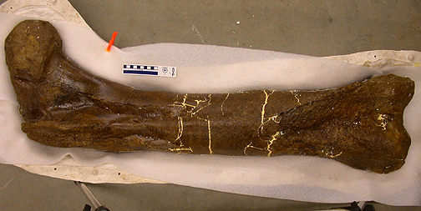
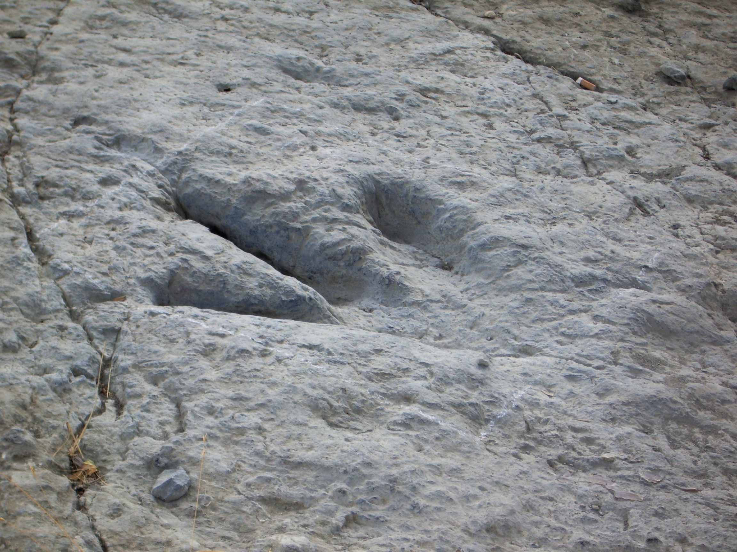
#2 Fossils & Correlation
Fossils
  Body Fossils
  Trace Fossils
To form most fossils:
  Hard parts
  Quick burial
Preservation rare but possible in ig/met rks

Slide 27
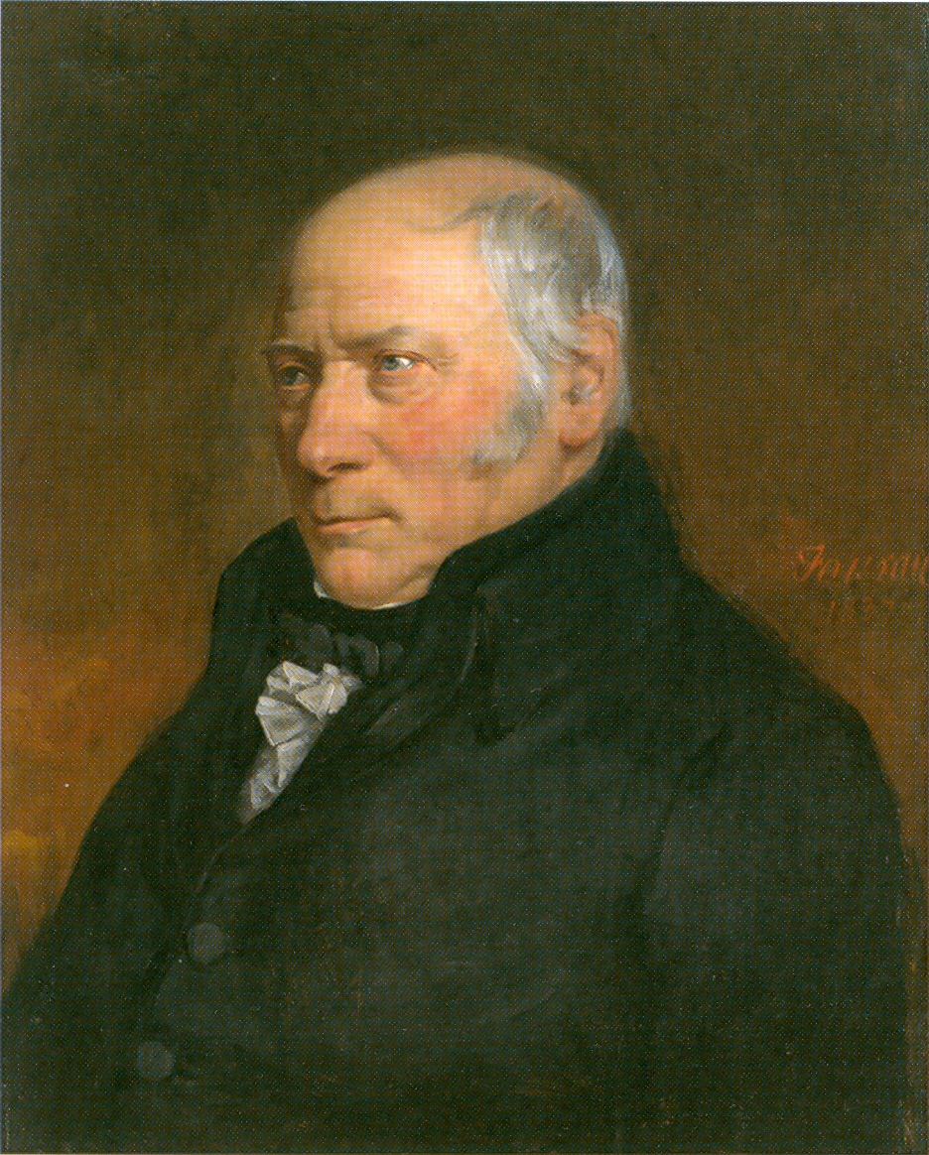
Fossils & Correlation
Smith (early 1800s)
Principle #6- P. Faunal Succession-
Pre-Darwin
1st mammoths
1st dinosaurs
1st fish
1st trilobites

Slide 28
Biostratigraphy
Very powerful correlation tool
1st mammoths
1st dinosaurs
1st dinosaurs
1st fish
1st Fish
1st trilobites

Slide 29
Biostratigraphic Units
Biozones-
Based just on fossil content, not lithology or actual age
1- Range Zone-
  FAD
  LAD

Slide 30
Biostratigraphic Units
2- Concurrent Range Zone-
  Can get smaller increments
Last trilobites
Fish AND trilobites
1st fish
1st trilobites

Slide 31
Biostratigraphy
Not all fossils are great for correlation
  Ex- cockroaches
Index (Guide) fossils
  Were numerous
  widespread
  Went extinct quickly
  Are easy to identify

Slide 32
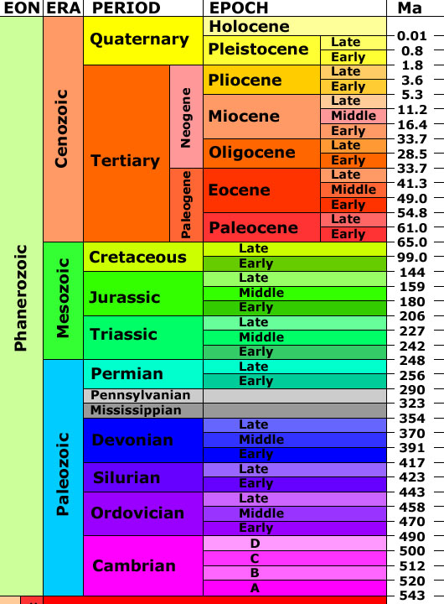
The geologic timescale was built via stratigraphic principles & biostratigraphy
1830s-1840s
Fossils were key for defining units & boundaries

Slide 33
Geologic Time Units
Based on actual age, not just lithology or fossil content
Time Units:
  Eon
  Era
  Period
  Epoch
  Age
Early, Middle, Late subdivisions

Slide 34
#3 Chronostratigraphy
Based on rocks formed during a specific time interval
    Ex: all the rocks formed during the Cretaceous
Chronostratigraaphic units:
  Eonothem
  Erathem
  System
  Series
  Stage
  Lower, Medial, Upper subdivisions
Match up w/ geologic time units, but these are used less (esp the larger increments)

Slide 35
#4 Correlation with Unconformities
Sequence Stratigraphy-
Sea level changes produce lots of unconformities

Slide 36
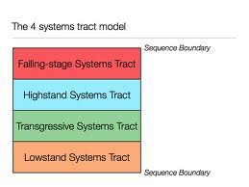
Sequence Stratigraphy
Predict & correlate order of beds (sequences) between the UCFs
Big in oil industry
Q: Why?

Slide 37
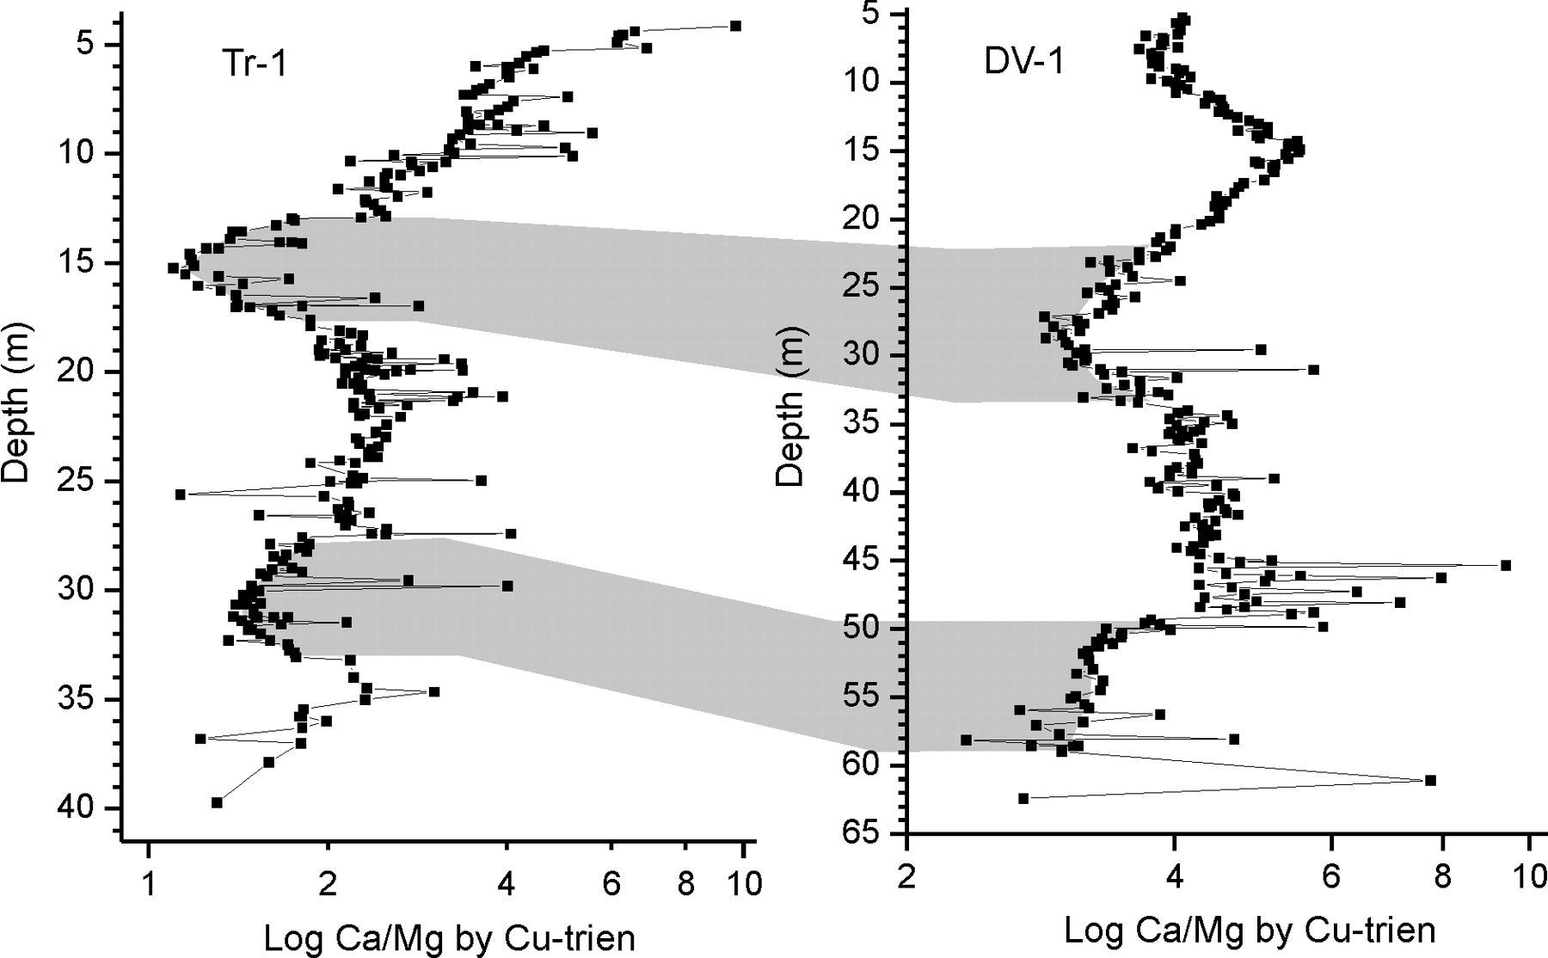
#5 Correlation with Chemistry
Chemostratigraphy-

Slide 38
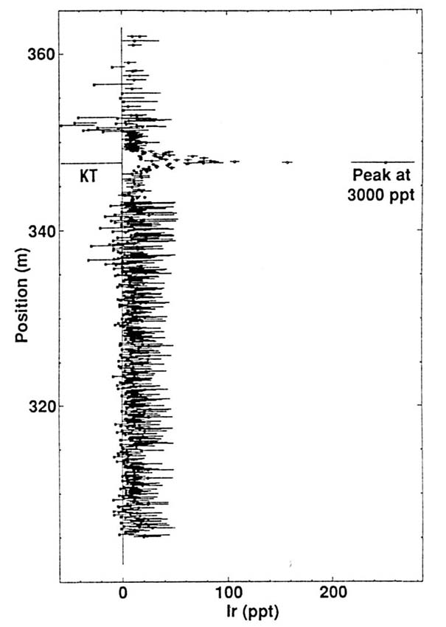
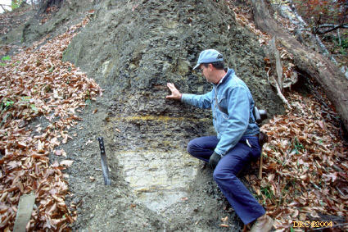
Chemostratigraphy
Ex- Iridium Anomaly

Slide 39
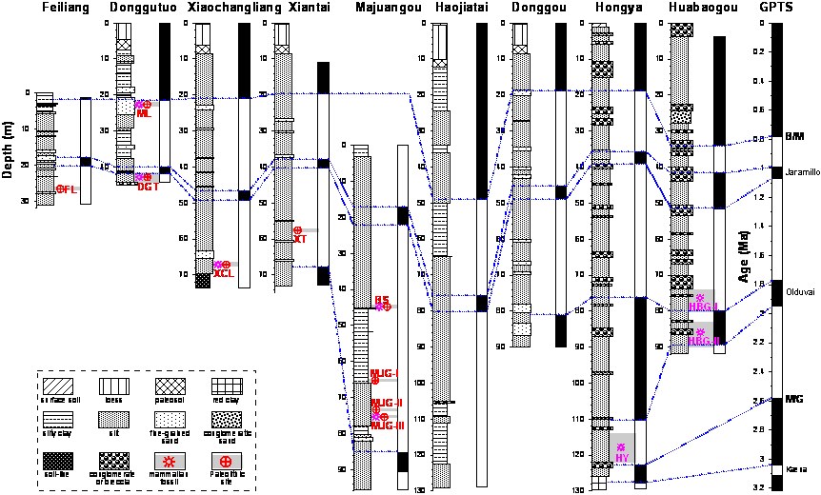
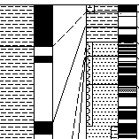
#6 Correlation with Magnetism
Magnetostratigraphy-

